Slide 1


Slide 2
Your data. Understood.

Slide 3




Canadian Greenhouse Gas Emissions Reporting
Analysis of Federal & City of Calgary Datasets

Slide 4






Meet
the Team
HOPE
ELIZABETH
FAHAD
Now accepting practicum positions ...
WAQAS
AHMED
MINA

Slide 5








Part 1:
Project Scope
Our Agenda
Part 2:
Business Problem
Part 3:
Goals & Process
Part 4:
Solution
Part 5:
Demonstration
Part 6:
Summary & Next Steps

Slide 6
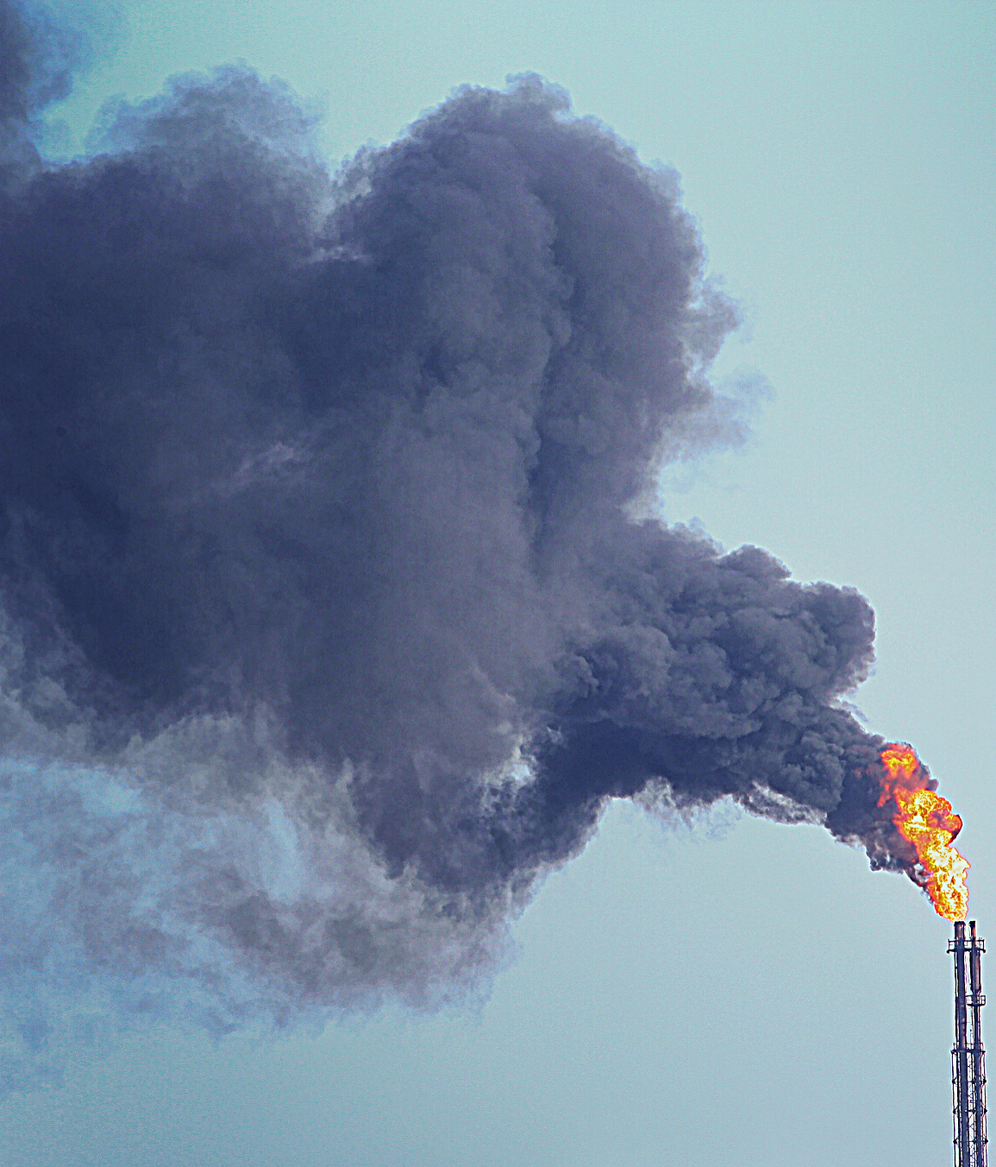
Project Scope
Let's just say the scope crept.

Slide 7



Greenhouse gas emissions are on the rise
Business Problem
Canada's commitment to the Paris Agreement
Carbon tax is here to stay and will increase each year

Slide 8
Strategic Goals

Slide 9

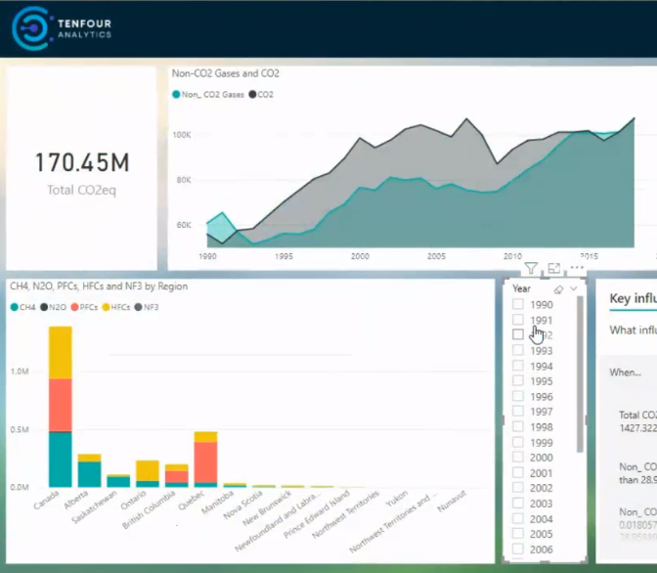

Our Solution
TenFour Analytics has transformed a large amount of lifeless, untidy flat-file-and-tabular-data into an interactive report and dynamic visualizations to empower users make better data-driven decisions.

Slide 10
Drumroll please...

Slide 11
What's Next?

Slide 12

Thank you!
Questions?

Slide 13
Sources
https://youtu.be/fTOQ4sZJBKs
https://ourworldindata.org/co2-and-other-greenhouse-gas-emissions

